Slide 1

Information Technology
Partner in reliable, state of the art, flexible technology solutions and services

Slide 2
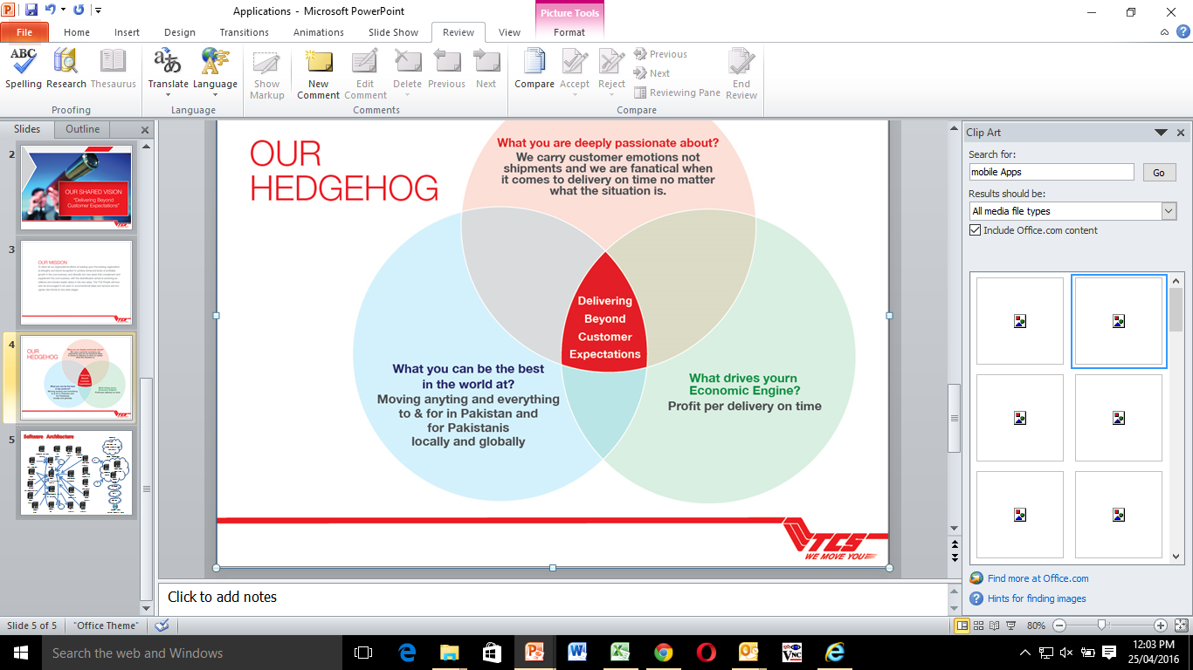
Agenda
QA Daily Activity Process

Slide 3
Daily Scrum
Define clear objectives of the day.
Deliveries and activities.
Serial # | Resource Name | Project Name | Delivery Today? | Delay? | Comments (If required)
1 | Farhan | NIR 242, NIR 200 & Pick Up API | NO | NO | API Test case & Test plan designing
2 | Qasim | TCS Hazir | NO | NO
3 | Waqqas | NIR 242, TTC & PICK API | NO | NO | API Test case & Test plan designing
4 | Faizan | CMI | NO | NO
5 | Faris | NIR 281 | NO | NO | Test Case & Test Plan designing
6 | Ayesha | NIR 230, NIR 239 | YES | YES | Fixes not provided Yet from Dev side.NIR 239 testing is Delayed from Consumer side
7 | Roohila | NIR 200 | NO | NO | Test Cases sent for approval.

Slide 4
Day End Status
Every individual will share his/her status on daily basis.
Serial # | Resource Name | Project Name | Task Description | Status | Comments (If required)
1 | Farhan |  |  | In Pro
2 | Waqqas | NIR - 242
3 | Qasim | TCS Hazir
4 | Faizan
5 | Roohila | NIR 200
6 | Ayesha | RMS Desktop
7 | Faris | NIR 214

Slide 5
Delay Task
Reasons:
Bugs.
Document not properly updated/discrepancy.
In Case of urgent requirement/Change.
If any other project becomes critical.
Due to tester.
Bugs:
All issues must be assigned to developer and there must be a comment on that. Developer will share the timeline and based on bug count, timeline for retesting will be shared and informed to PM.
Document not properly updated/discrepancy:
If there is a discrepancy in document, then the respective PM or BA must update the document and new timelines will be shared and informed to PM.
In Case of urgent requirement/Change:
Testing must be put on hold, timeline will be revised according to the development efforts and informed to PM.
If any other project becomes critical:
The current project will be put on Hold on the decision of PM and timelines will be revised.
Due to tester:
This will be count in poor performance and will impact his scoring. Also the timelines for next day must not be impacted and resource has to spend extra hours.

Slide 6
Testing Status Report For Team
Project Testing is Completed.
Three Documents will be shared with the whole team.
Test Plan, Test Cases and Release notes.
Project Freeze/Closure Document.
Statistics of Bugs (Can be manual or can be extracted from Mantis)
Total number of bugs=
New issues =
Not fixed =
Fixed =
Project Testing in Progress.
Statistics of Bugs (Can be manual or can be extracted from Mantis)
Total number of bugs=
New issues =
Not fixed =
Fixed =

